Slide 1


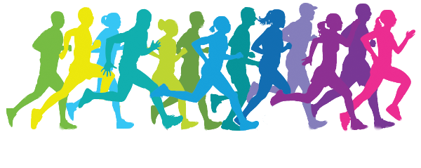
Unit 3 On the move
P1 Starting out

Slide 2
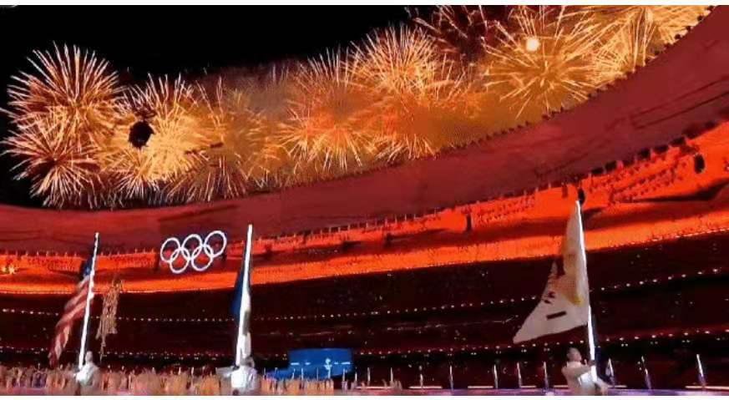
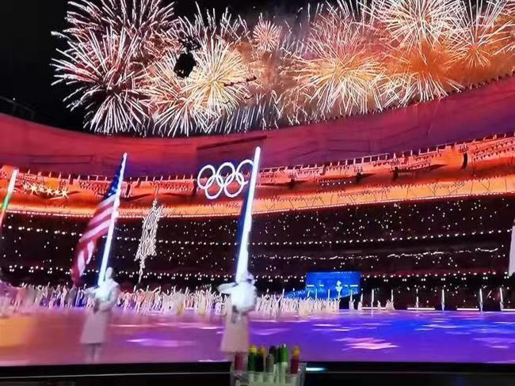
What event is it?

Slide 3
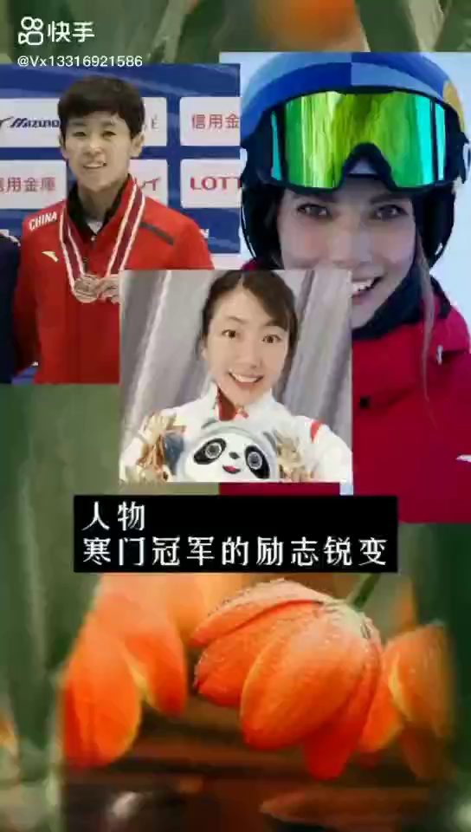

Slide 4
What do you think after watching the video?

Slide 5
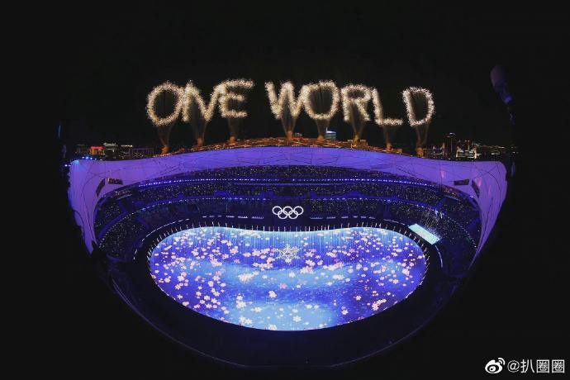
What do you think about the theme in the picture?

Slide 6

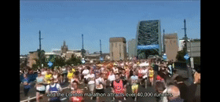


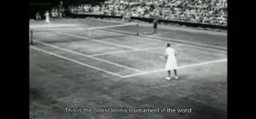
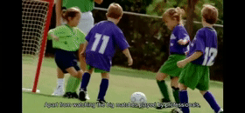
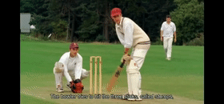
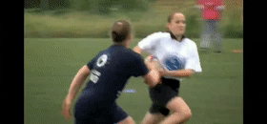
Watch and say
Watch the video and answer the question:
marathon race
Which one do you like best? Why?
What sports are mentioned in the video?
tennis
cricket(板球)
rugby
football/soccer

Slide 7


Talk about your favourite sport
Watch a video and figure out the structures to talk about your likes.
I really love …
I’m a big fan of …
What I really like/enjoy is …
My (absolute) favourite sport to do
is …
… makes me happy.
Doing … makes me feel good.

Slide 8
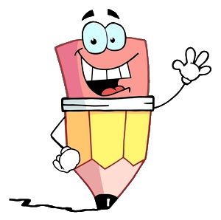
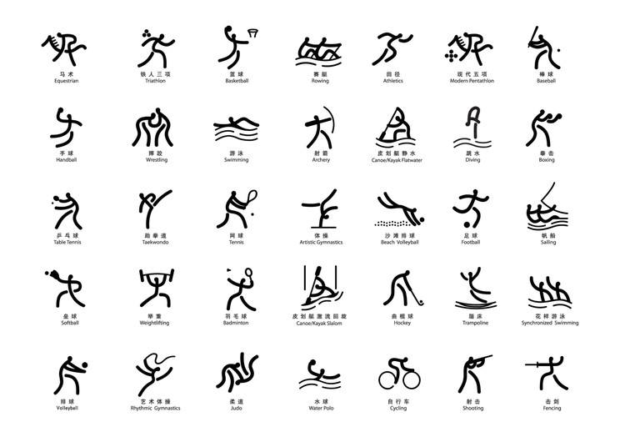

Can you brainstorm more sports?

Slide 9

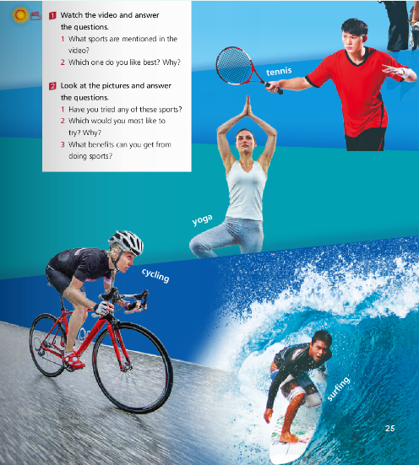
Look at the pictures and answer the questions.
Have you tried any of these sports?
Which would you most like to try? Why?
What benefits can you get from doing sports?

Slide 10
The benefits you can get from doing sports
Sports improve sleep habits.
Sports improve your mood.
Sports help you maintain a healthy weight.
Sports improve your concentration.
Sports reduce stress and depression.
Sports boost your self-confidence.
...

Slide 11


Self-evaluation
1. Can you list at least 10 sporting items?
2. Can you share your favourite sport with
others?
3. Can you figure out the benefits you can
get from doing sports?

Slide 12
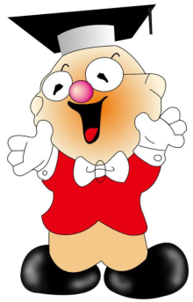
Homework
1. Collect at least 20 sporting events.
2. Finish exercises in Learning
English.

